Slide 1
Botanical Identification of Plant Based Crude drug Materials and their Adulterants
H. B. Singh & Kumar Avinash Bharati
Raw Materials Herbarium & Museum (RHMD)
CSIR - National Institute of Science Communication And Information Resources (NISCAIR),
Pusa Campus, Dr. K. S. Krishnan Marg,
New Delhi- 110012

Slide 2
CURRENT STATUS OF MEDICINAL PLANTS
IN THE WORLD
Total number of Plants | 3,00,000
Flowering plant Reported | 2,58,650
Plants used as MP in World | 35,000-70,000
World’s medicinal plants in trade | 4,000-6,000
Total volume of medicinal plants in trade | 440,000 metric tons
Value of World herbal trade | 120 Billion US $
Expected to reach by 2050 | 5 trillion US $

Slide 3
CURRENT STATUS OF MEDICINAL PLANTS
IN INDIA
Total number of plants in India | 46,340
Flowering plants in India | 17,643
Used as MP in India (Codified + non codified) | 6,000-7,000
Plants used in ISM (in AYUSH) | 2,208
Plants in trade in India | 960
Value of MP trade in India (Domestic) | Rs. 80 to 90 billion
Export value of MP of India | Rs. 10 billion
Source: BSI (2010)

Slide 4
PLANTS USED IN ALL CODIFIED SYSTEMS OF MEDICINE IN INDIA
AYURVEDA | 1587
SIDDHA | 1128
UNANI | 503
HOMOEOPATHY | 468
AMCHI / SWA-RIGPA | 253
MODERN / WESTERN MEDICINE | 192
TOTAL | 2,400

Slide 5
TARGETED DEMAND FOR 2015
Markets | Present | Targeted
Europe | US$ 35 million | US$ 70 billion
USA | US$ 6.5 billion | US$ 25 billion
China | US$4.0 billion | US$ 12 billion
India | US$1.5 billion | US$ 3 billion
Others | US$ 13 Billion | US$ 30 billion
Total | US $ 60 Billion | US$140 billion
Source: ASSOCHAM, 2010

Slide 6
GAP IN DEMAND AND SYPPLY OF
MEDICINAL PLANTS
Over 90% MP are collected from wild that may be one of the several other factors like destructive harvesting for commercial purposes, habitat degradation , habitat loss and habitat fragmentation for depletion of natural resources of medicinal plants
Therefore, availability of medicinal plants is less to meet the ever-growing demand of these plants. Hence, there is a gap in demand and supply that may lead to adulteration and substitution of genuine material

Slide 7
Adulteration deteriorates quality
Use of adulterated materials for manufacturing medicine deteriorate quality and efficacy of the product
Some adulterants have toxic compounds
Keeping this in view NISCAIR established Raw Materials Herbarium & Museum (RHMD) for authentication of crude drugs

Slide 8
No. of samples received for identification from April, 2010 to March, 2011
Month | No. of samples received | No. of samples found wrong | % of wrong samples
April | 15 | 3 | 20.00
May | 12 | 2 | 16.00
June | 31 | 3 | 09.69
July | 79 | 2 | 02.53
August | 42 | 4 | 09.50
September | 60 | 13 | 21.66
October | 33 | 3 | 09.09
November | 58 | 17 | 29.31
December | 51 | 7 | 13.72
January | 50 | 5 | 10.00
February | 70 | 7 | 10.00
March | 35 | 3 | 08.57
Total | 536 | 69 | 12.31

Slide 9
List of the plants identified wrong
S. No. | Sample Received as | Part | Identified as
01 | Corchorus species | Aerial part | Crotalaria juncea
02 | Belladona | Aerial part | Nicandra physaloides (L.) Gaertn.
03 | Phyllanthus niruri | Whole plant | Phyllanthus amarus Schumach. & Thonn.
04 | Suaeda fruticosa | Whole plant | Suaeda maritima (L.) Dumort.
05 | Leucas cephalotes | Whole plant | Spermacoce articularis L.f. Syn. Borreria articularis (L.f.) F.N.Williams

Slide 10
S. No. | Sample Received as | Part | Identified as
06 | Pulsatilla nigricans | Whole plant | Gentiana olivieri Griseb.
07 | Trichosanthes dioca | Whole plant | Rhynchosia capitata DC.
08 | Chelidonium majus | Whole plant | Euphorbia dracunculoides
09 | Zoofa yabis | Whole plant | Nepata bracteata Benth
10 | Ipomoea turpethum | Stem bark | Marsdenia tenacissima (Roxb ) Moon
11 | Saraca asoca | Stem bark | Shorea robusta Gaertn.
12 | Rhamnus catharicus | Fruits | Frangula purshiana (DC.) Cooper
13 | Kala jeera | Fruits | Vernonia anthelmintica (L.) Willd. Syn..Centratherum anthelminticum L..

Slide 11
S. No. | Sample Received as | Part | Identified as
14 | Citrus aurantium | Fruits | Citrus limettiides Tanaka
15 | Momordica charanttia | Fruits | Momordica tuberosa Roxb.
16 | Alpinia galanga | Rhizomes | Alpinia calcarata (Haw.) Roscoe
17 | Curcuma amada | Rhizomes | Curcuma aromatica Salisb.
18 | Abies webbiana | Leaves | Taxus wallichiana Zucc.
19 | Uva ursi (Arctostaphylos uva-ursi) | Leaves | Vaccinium arctostaphylos
20 | Lerodendrum serratum | Leaves | Clerodendrum indicum (L.) Kuntze
21 | Psidium littorale | Leaves | Psidium guajava L.

Slide 12
S. No. | Sample Received as | Part | Identified as
22 | Origanum majorana | leaves | Ocimum basilicum L.
23 | Capparis spinosa | Leaves | Capparis brevispina DC.
24 | Jasminum officinale | Leaves | Jasninum grandiflorum
25 | Jasminun auriculatum | Leaves | Jasminum multiflorum (Burm.f.) Andrews
26 | Belladonna | Leaves | Datura metal L.
27 | Hibiscus rosa -sinensis | Flowers | Rhododendron arboreum Sm.
28 | Althea officinalis | Seeds | Alcea rosea L.
30 | Datura straminium | Seeds | Datura inoxia Mill

Slide 13
S. No. | Sample Received as | Part | Identified as
31 | Inula racemosa | Roots | Saussurea costus (Falc.) Lipsch.
32 | Drosera rotundifolia | Roots | Drosera burmanni Vahl.
33 | Hemidesmus indicus | Roots | Decalepis hamiltonii Wt. Arn.
34 | Hemidesmus indicus | Roots | Ichnocarpus frutescens B.Br.
35 | Salacia oblonga | Roots | Berberis aristata DC.

Slide 14
S. No. | Sample Received as | Part | Identified as
36 | Aconitum heterophyllum | Roots | Chaerophyllum villosum Wall. ex DC.
37 | Arnica Montana | Roots | Polypodium vulgare L.
38 | Ammannia baccifera | Roots | Corchorus depressus (L.) Stocks.
39 | Colchicum autumnale | Corm | Colchicum luteum Baker

Slide 15
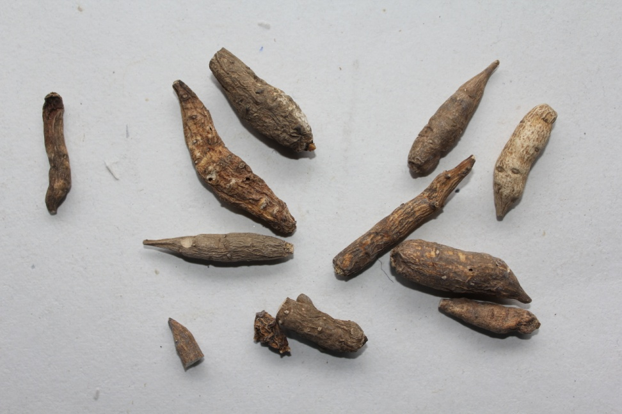
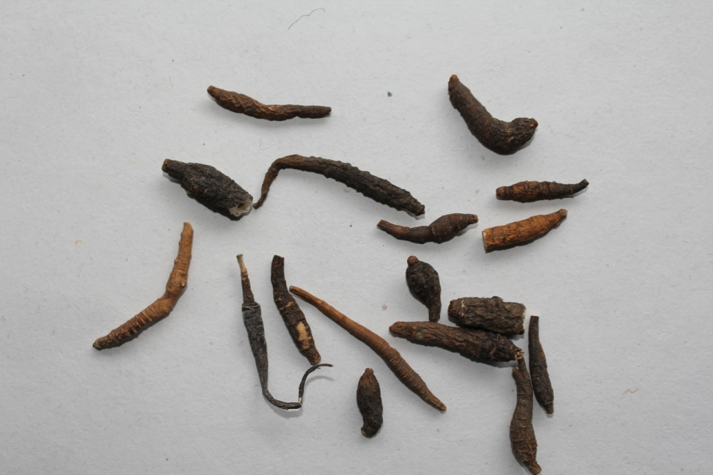
Sample received as Aconitum heterophyllum but it was Chaerophyllum villosum
Aconitum heterophyllum
Chaerophyllum villosum

Slide 16
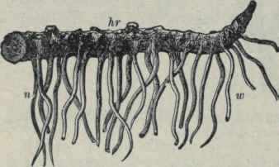
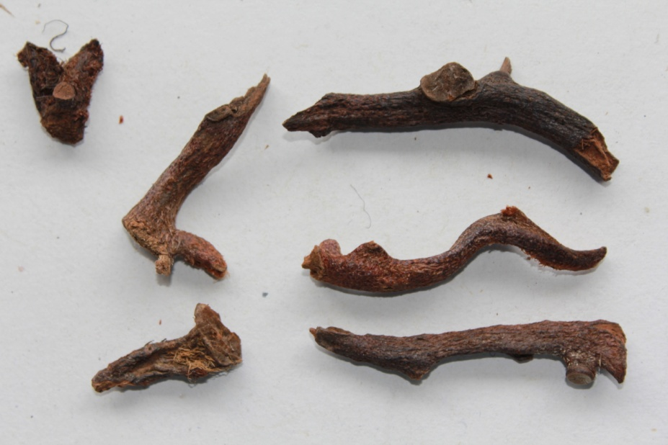
Sample received as Arnica montana but it was Polypodium vulgare
Arnica montana
Polypodium vulgare

Slide 17
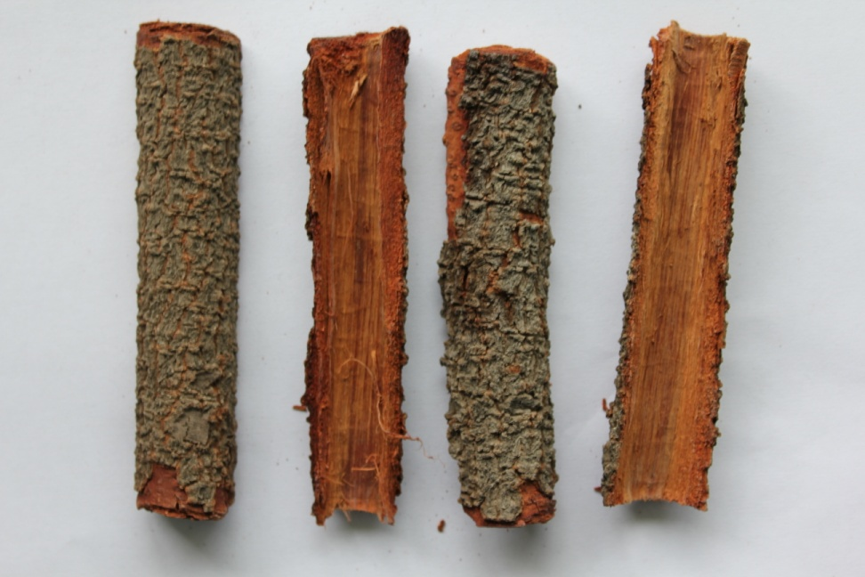
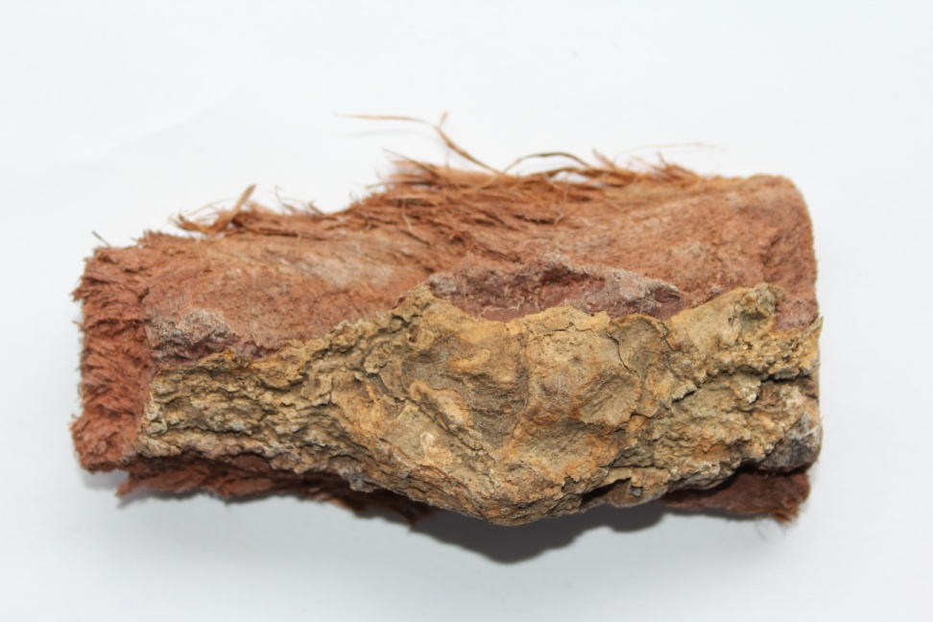
Sample received as Saraca asoca but it was Shorea robusta
Saraca asoca
Shorea robusta

Slide 18
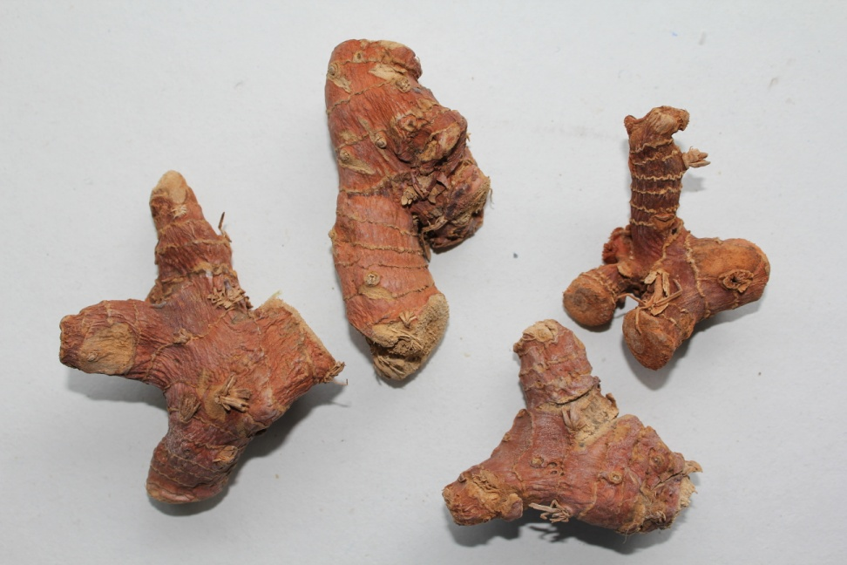
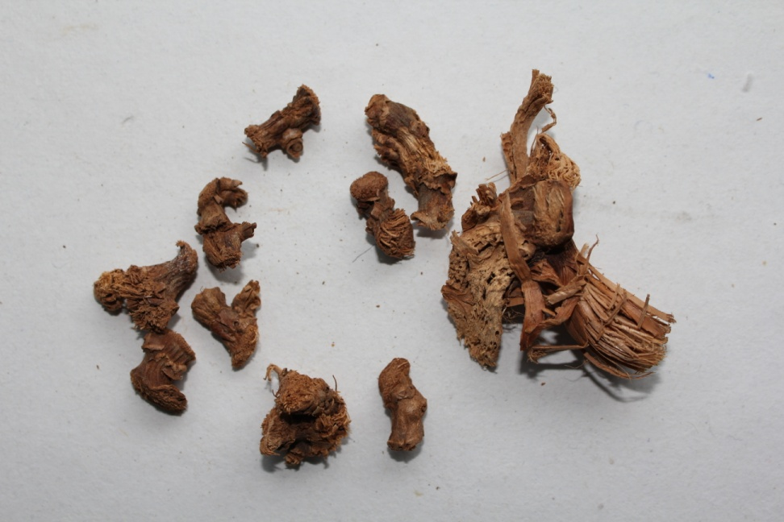
Sample received as Alpinia galanga but it was Alpinia calcarata
Alpinia galanga
Alpinia calcarata

Slide 19
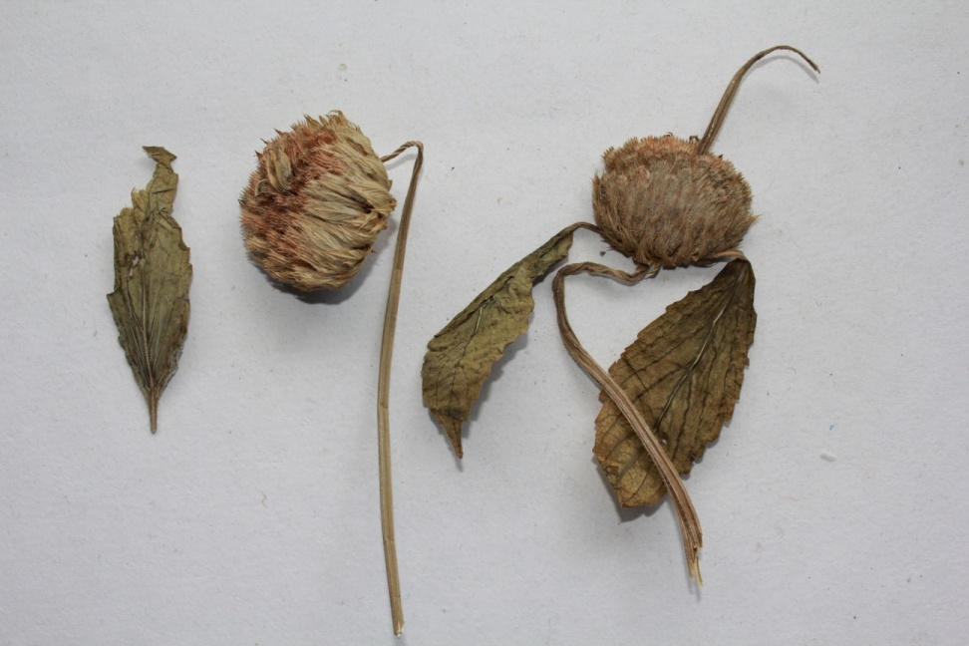
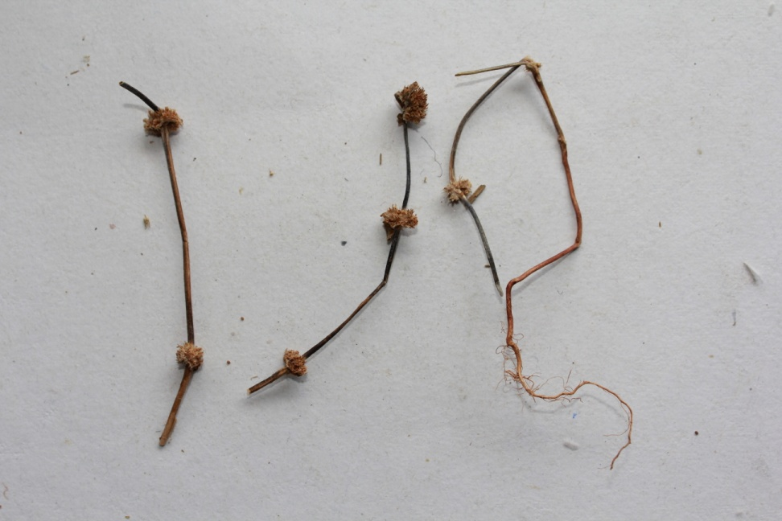
Sample received as Leucas cephalotes but it was Spermacoce articularis
Leucas cephalotes
Spermacoce articularis syn. Borreria articularis

Slide 20
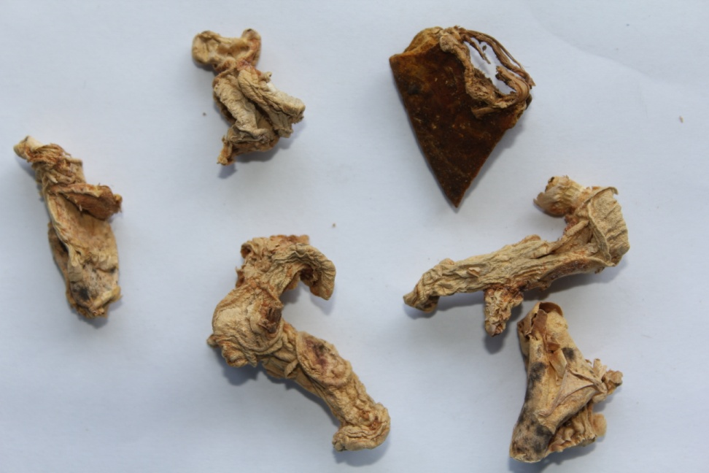
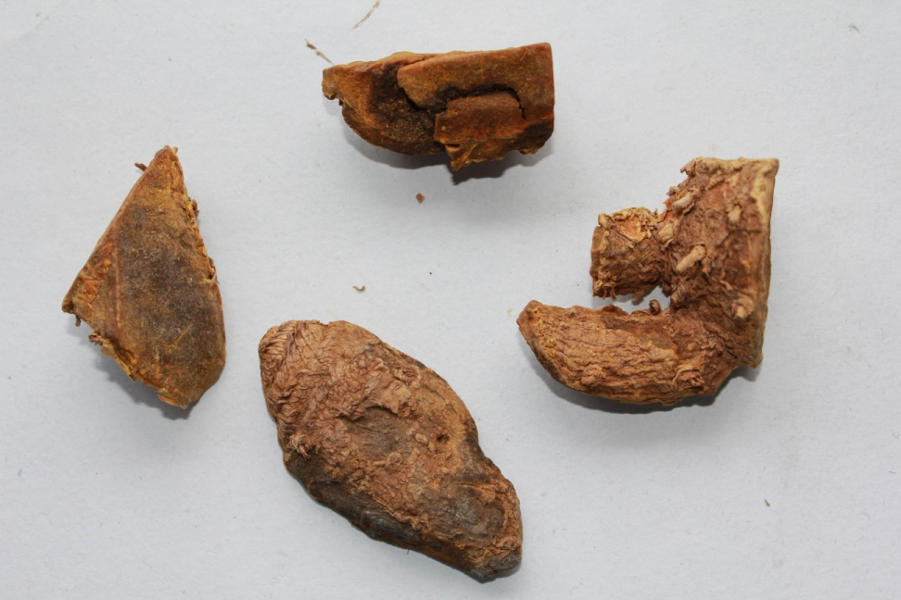
Sample received as Curcuma amada but it was Curcuma aromatica
Curcuma amada
Curcuma aromatica

Slide 21
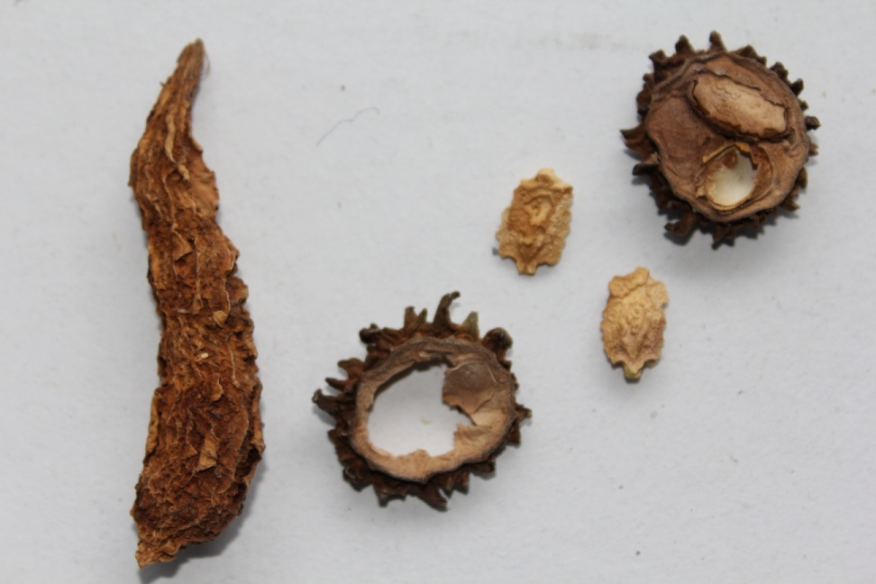
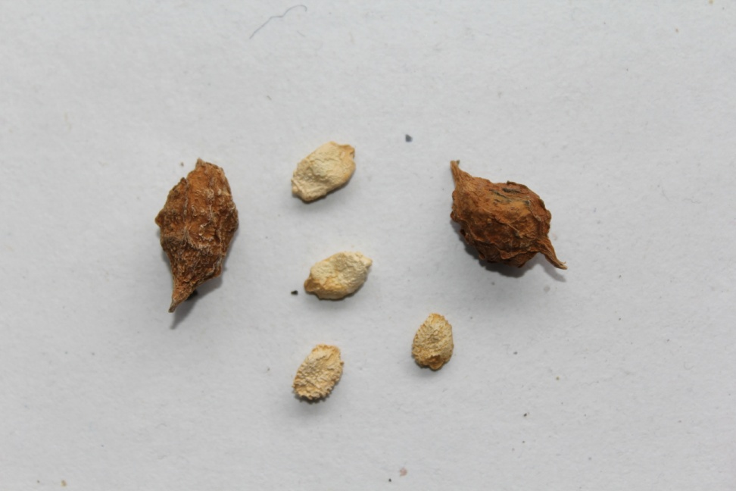
Sample received as Momordica charantia but it was Momordica tuberosa
Momordica charantia
Momordica tuberosa

Slide 22
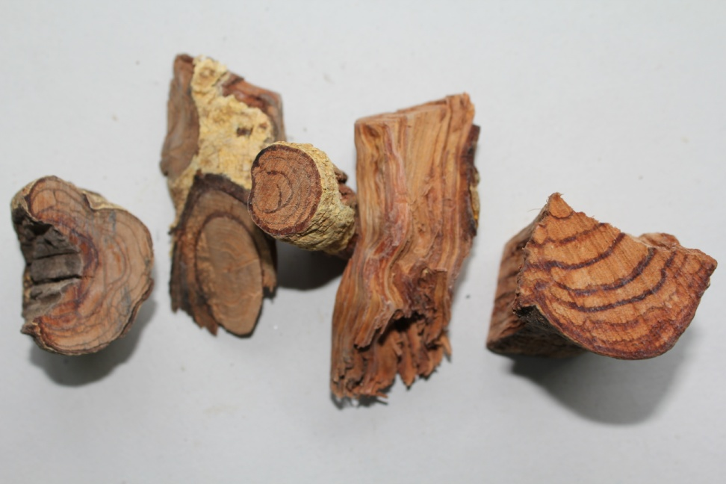
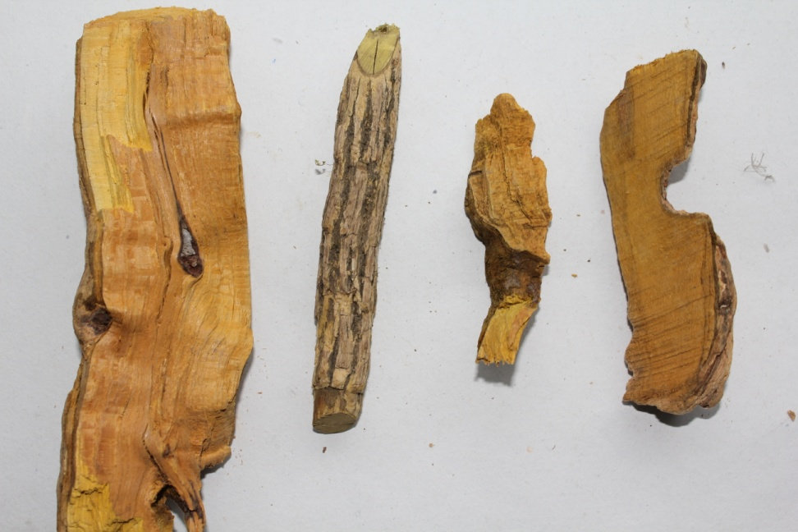
Sample received as Salacia oblonga but it was Berberis artistata
Salacia oblonga
Berberis aristata

Slide 23
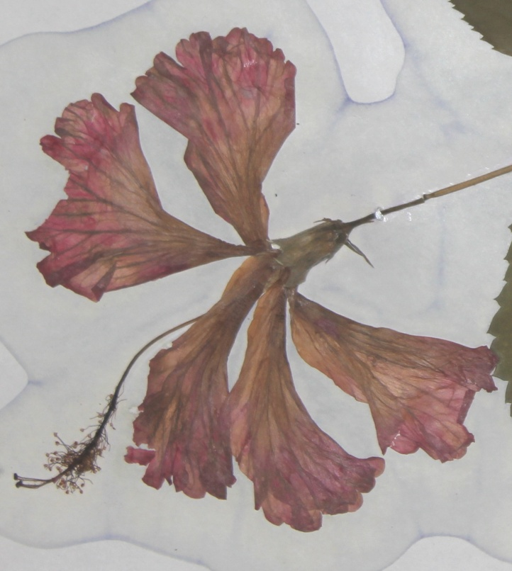
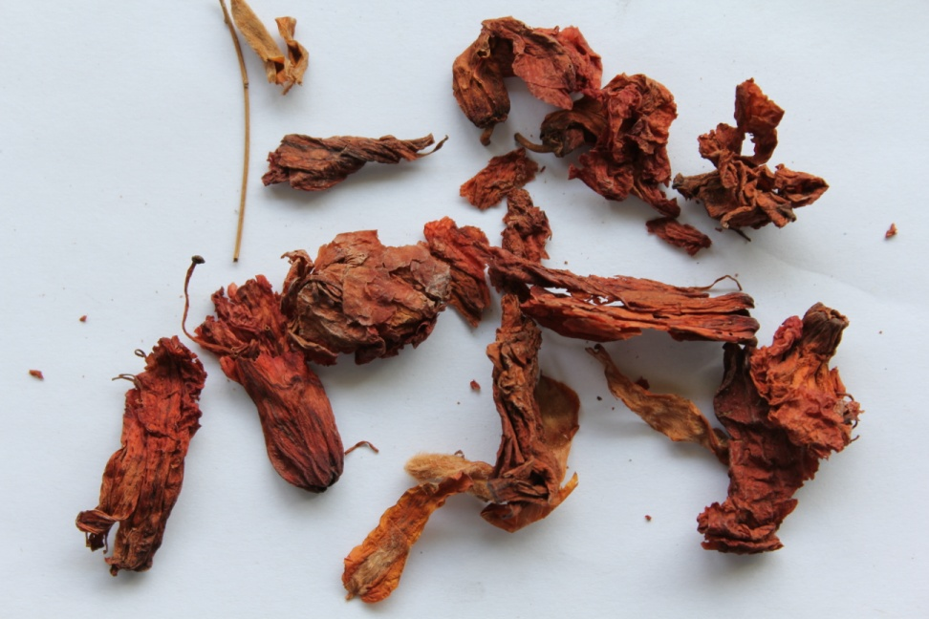
Sample received as Hibiscus rosa-sinensis but it was Rhododendron arboreum
Hibiscus rosa-sinensis
Rhododendron arboreum

Slide 24
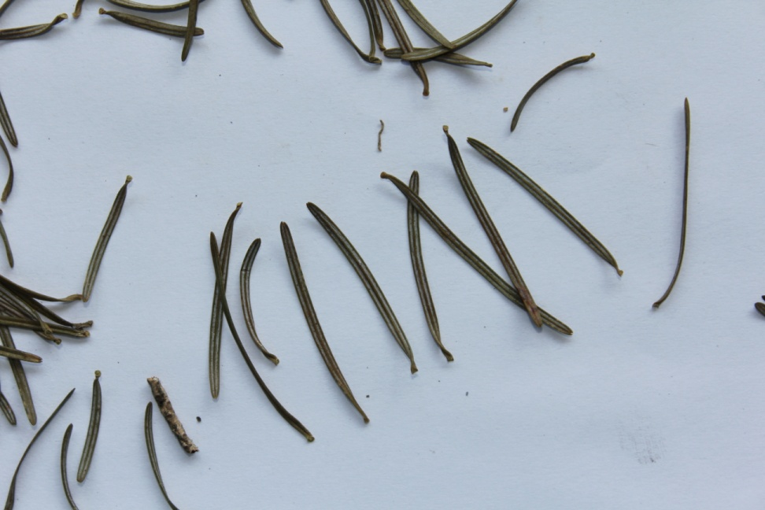
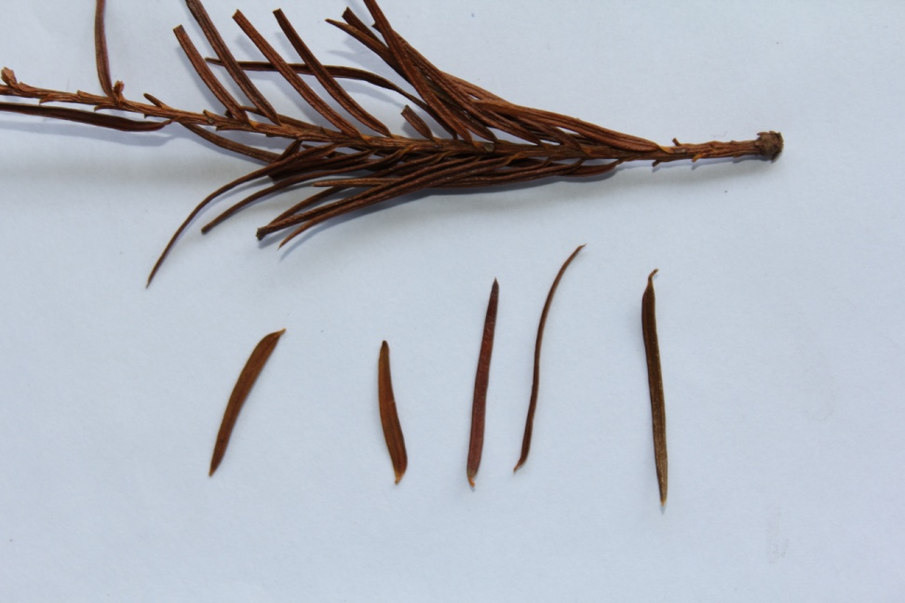
Sample received as Abies spectabilis but it was Taxus wallichiana
Abies spectabilis
Taxus wallichiana

Slide 25
CONCLUSION
To ensure quality, safety and efficacy of the herbal medicines the starting raw materials should be authentic and of the best quality
Herbarium specimens of medicinal plants and parts thereof should be collected and maintained in a herbarium as authentic reference collections that may be used as a source material for comparative studies of morphological, anatomical, Chemical, and DNA finger printing.

Slide 26
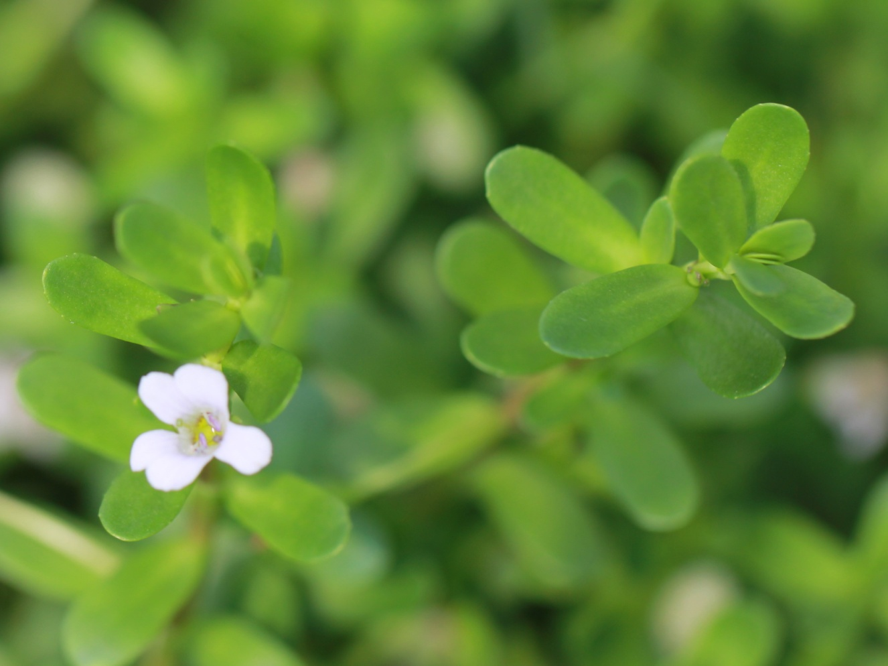
Thank you
ब्रह्मी Bacopa monnieri (L.) Pennell

